Slide 1
Statistical Inference for Two Samples
10

Slide 2
LO
On difference of two population mean/proportions:
confidence intervals
test of hypotheses
Discuss on sample sizes

Slide 3
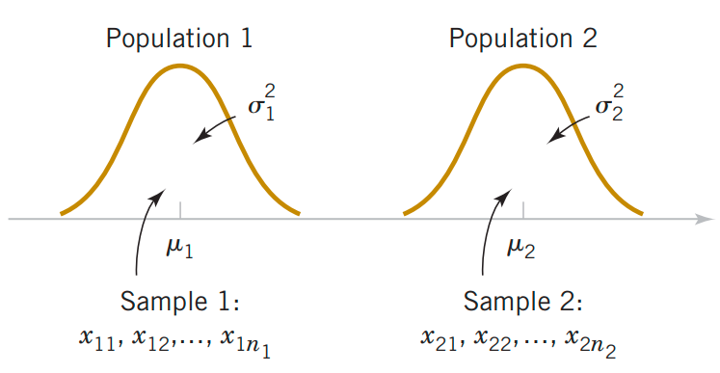
Inference on the Difference in Means of Two Normal Distributions, Variances Known
Assumptions for Two-Sample Inference
X₁₁, X₁₂, …, X_{1n1} is a random sample from population
X₂₁, X₂₂, …, X_{2n2} is a random sample from population
The two populations represented by X₁ and X₂ are independent.
(4) Both populations are normal.
Two independent populations

Slide 4
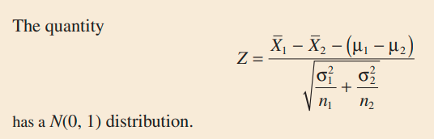
Tests on the Difference in Means, Variances Known

Slide 5
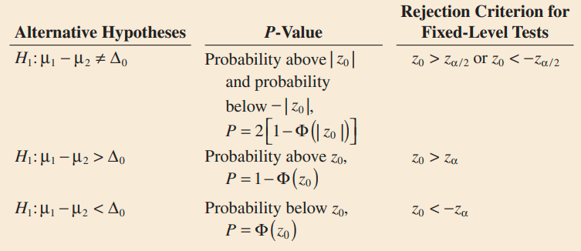
Tests on the Difference in Means, Variances Known
Null hypothesis
and test statistic:
Ex. A manager evaluates effectiveness of a major hardware upgrade by running a certain process 50 times before the upgrade and 50 times after it. Based on these data, the average running time is 8.5 minutes before the upgrade, 7.2 minutes after it. Historically, the standard deviation has been 1.8 minutes, and presumably it has not changed. Test on the difference between the means of running time. Use α = 0.05.

Slide 6

Confidence Interval
Ex. A manager evaluates effectiveness of a major hardware upgrade by running a certain process 50 times before the upgrade and 50 times after it. Based on these data, the average running time is 8.5 minutes before the upgrade, 7.2 minutes after it. Historically, the standard deviation has been 1.8 minutes, and presumably it has not changed. Construct a 95% confidence interval showing how much the mean running time reduced due to the hardware upgrade.

Slide 7
Choice of Sample Size
The sample size required so that the error in estimating μ₁ − μ₂ by x₁ - x₂ will be less than E at 100(1 − α)% confidence.
Ex. A manager evaluates effectiveness of a major hardware upgrade by running a certain process 50 times before the upgrade and 50 times after it. Based on these data, the average running time is 8.5 minutes before the upgrade, 7.2 minutes after it. Historically, the standard deviation has been 1.8 minutes, and presumably it has not changed. What sample size would be required in each population if you wanted to be 95% confident that the error in estimating the difference in mean running time is less than 0.5 minute?

Slide 8
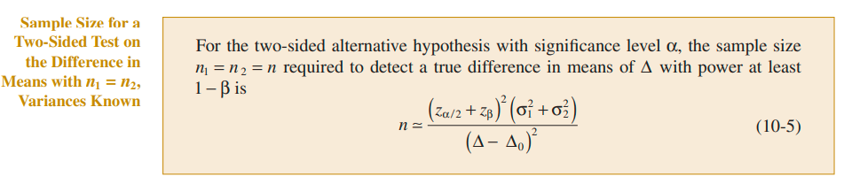
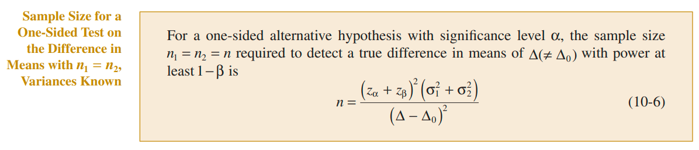
Sample Size Formulas

Slide 9
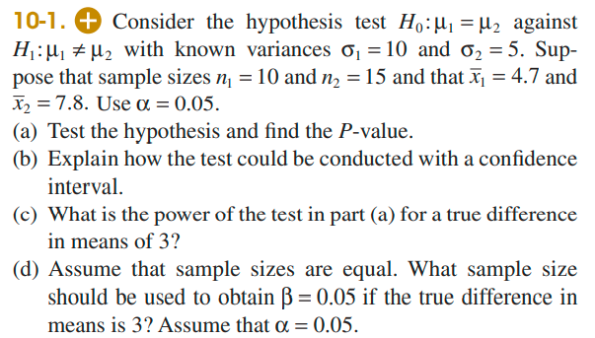
Exercise

Slide 10
Unknown σ²
What if variance σ² is unknown?
Use large sample size (n₁ and n₂  30) and sample variances s₁² s₂² instead of population variances σ₁² , σ₂² which are unknown.
Ex. A test is conducted to compare breaking strength of cell phones manufactured by two companies. Summary data are given below.
Company A: n₁ = 65, ‾x₁ = 107 pounds, s₁ = 10 pounds
Company B: n₂ = 60, ‾x₂ = 113 pounds, s₂ = 13 pounds
Use α = 0.05.

Slide 11
Example
Parameter of interest: μ₁ − μ₂ and Δ₀ = 0
H₀: μ₁ − μ₂ = Δ₀ = 0
H₁: μ₁ < μ₂
Test statistic:
P-value = P(Z < -2.875) = 0.002
Conclusion: Reject H₀ at the α = 0.05 level

Slide 12
Unknown variances, large samples
Ex. Internet connections are often slowed by delays at nodes. Let us determine if the delay time increases during heavy-volume times. Five hundred packets are sent through the same network between 5 pm and 6 pm (sample X₁), and three hundred packets are sent between 10 pm and 11 pm (sample X₂). The early sample has a mean delay time of 0.8 sec with a standard deviation of 0.1 sec whereas the second sample has a mean delay time of 0.5 sec with a standard deviation of 0.08 sec. Construct a 95% confidence interval for the difference between the mean delay times.

Slide 13
Unknown variances, large samples
Ex. Internet connections are often slowed by delays at nodes. Let us determine if the delay time increases during heavy-volume times. Five hundred packets are sent through the same network between 5 pm and 6 pm (sample X₁), and three hundred packets are sent between 10 pm and 11 pm (sample X₂). The early sample has a mean delay time of 0.8 sec with a standard deviation of 0.1 sec whereas the second sample has a mean delay time of 0.5 sec with a standard deviation of 0.08 sec. Test on the difference between the mean delay times at 0.05 level of significance.

Slide 14
Exercise
Grades of two classes:
Class A: n₁ = 31, ‾x_{A} = 4.48, s₁ = 1.78
Class B: n₂ = 30, ‾x_{B} = 5.39, s₂ = 1.67
a/ Test H₀: μ₁ = μ₂
vs H₁: H₀: μ₁ < μ₂
at the α = 0.05 level of significance
b/ Construct 95% confidence interval for μ₁ - μ₂

Slide 15
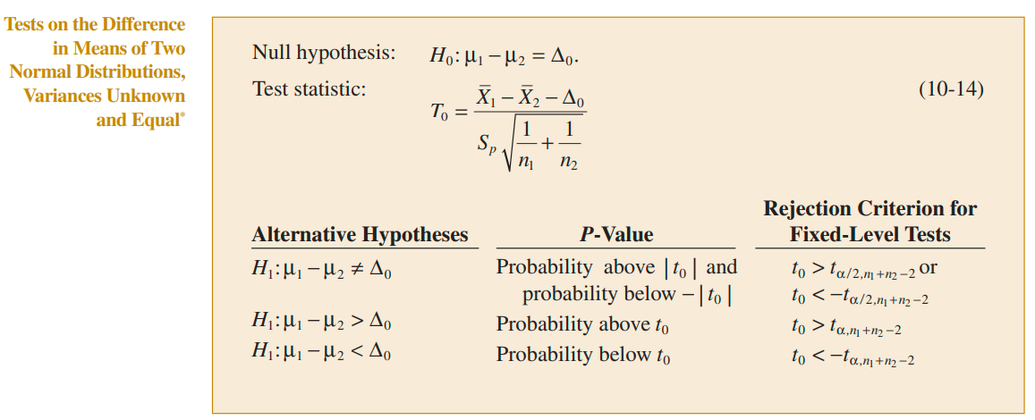

Unknown variance, small samples
σ₁ = σ₂ = σ
t distribution with n₁ + n₂ – 2 degrees of freedom

Slide 16
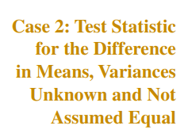

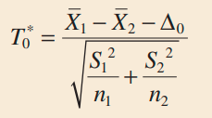
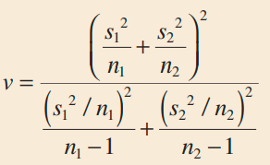
Unknown variance, small samples
σ₁ ≠ σ₂
t distribution with ν degrees of freedom
Notes:
x <- c(5,6,5,7,8,9,4)
y <- c(6,6,4,7,5,6,4)
t.test(x,y,alternative=‘greater’)

Slide 17
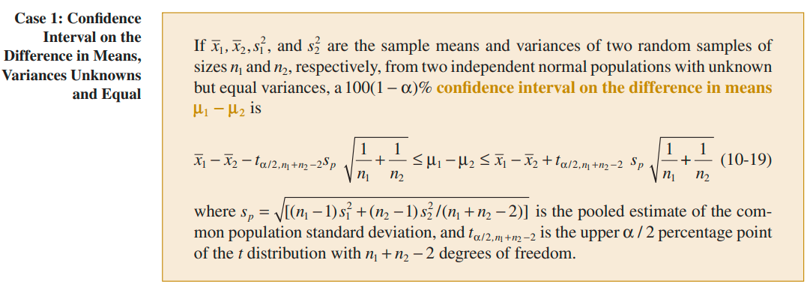
Confidence Interval

Slide 18
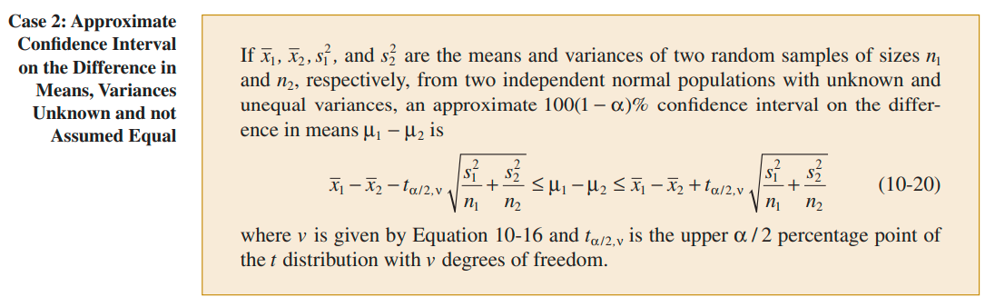
Confidence Interval

Slide 19
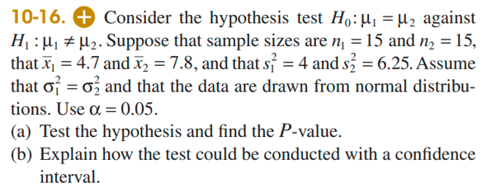
Notes:
P(T > t0) + P(T < -t0)

Slide 20
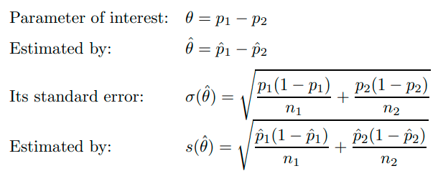
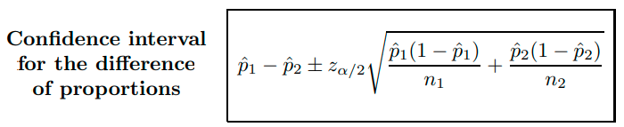
On the difference of proportions

Slide 21
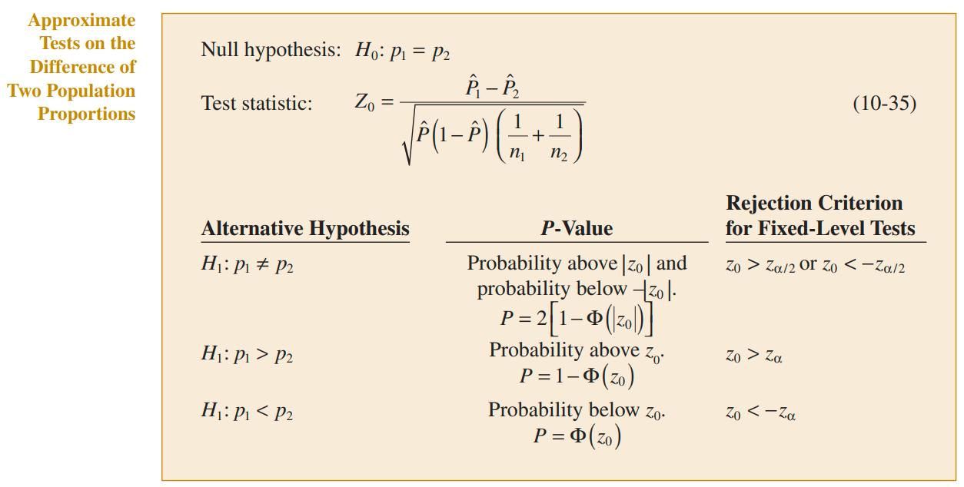

Slide 22
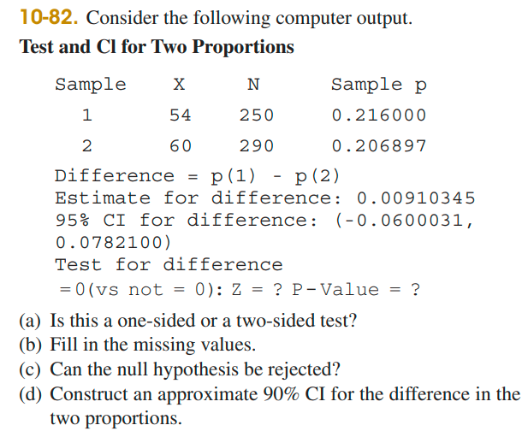

Slide 23
Summary
On difference of two population mean/proportions:
confidence intervals
test of hypotheses
Discuss on sample sizes

